Slide 1


IEEE 802.11e
QoS & Baseline
Reproduction
Literature Review (Mangold 2003 & Xiao 2005)
& ns-3.48 Empirical Evaluation
A3 Assignment

Slide 2
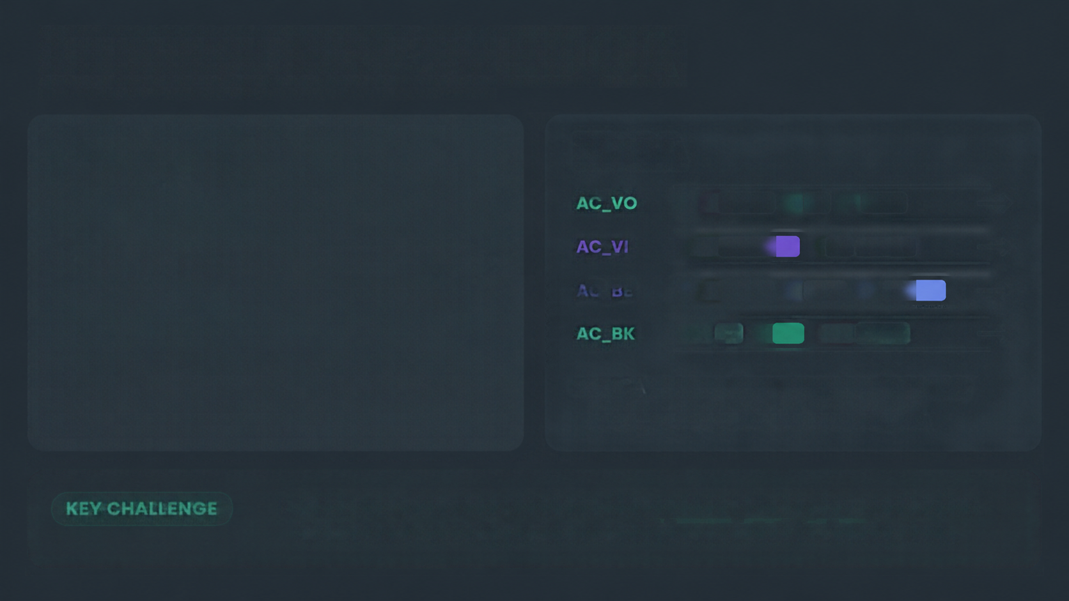

























Legacy DCF vs
EDCA
EDCA
Legacy DCF
AC_BE
  Legacy DCF uses one best-effort lane, so voice packets can wait behind heavy data.
  EDCA creates four access categories: AC_VO, AC_VI, AC_BE, and AC_BK.
KEY CHALLENGE
  AIFS and contention windows differentiate priority, but small voice CW bounds can trigger severe collisions as station density rises.

Slide 3


Mangold et al. (2003): Setup
1
EDCA CWmin/CWmax
AP + Stations
Voice
3/7
Video
7/15
N = 1 to 16
Best Effort
15/1023
Background
15/1023
• PHY Rate: 24 Mbps (Data) | 6 Mbps (Control)
• Offered Load: 1.0 Mbps/stream (4.0 Mbps total per station)
• EDCA Bounds (CWmin/CWmax): Voice (3/7), Video (7/15), Best Effort (15/1023), Background (15/1023)

Slide 4

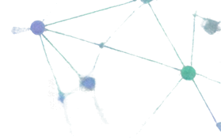

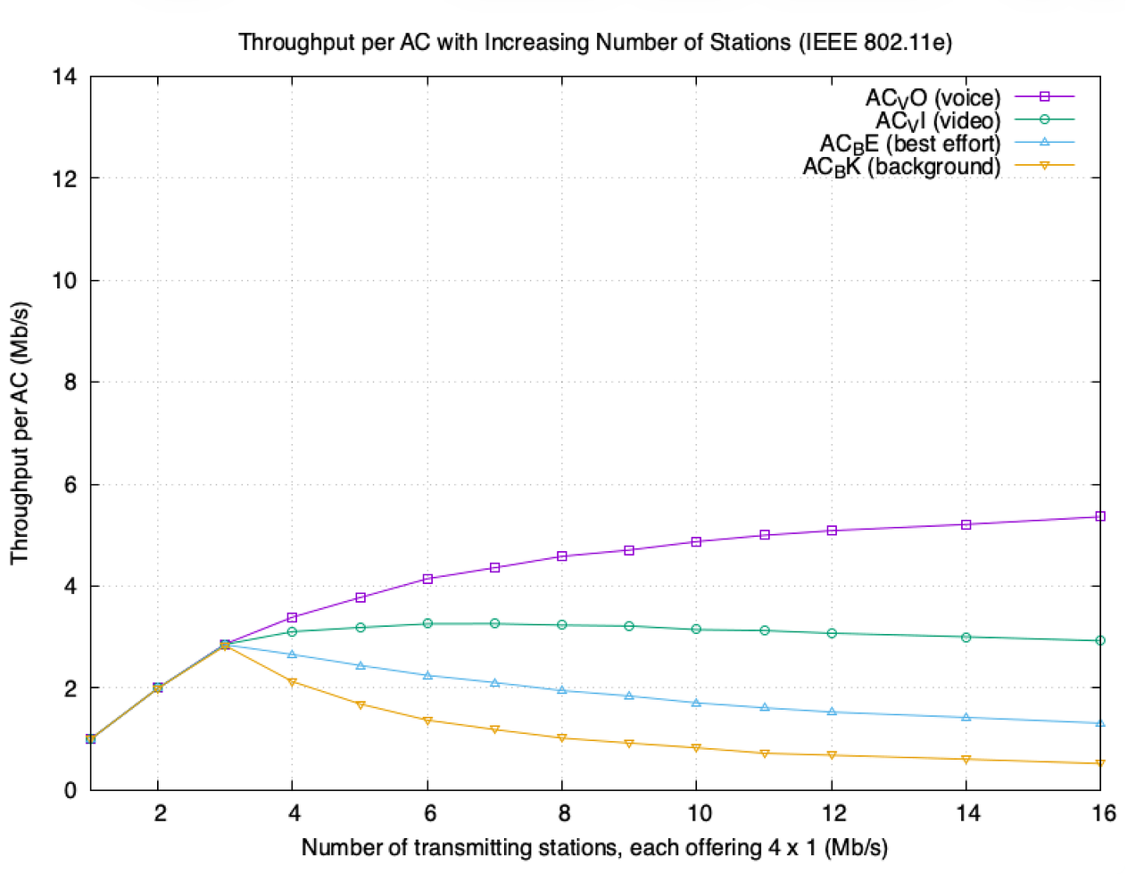
ns-3.48
Empirical Reproduction
  For N≤3, all categories deliver 100% throughput.
  For N≥4, the priority order is AC_VO > AC_VI > AC_BE > AC_BK.
  At N=16, voice reaches
5.36 Mbps
while
background falls to
0.52 Mbps.

Slide 5








Validated Ranking
Simulation vs. Paper:
Agreement and Difference
AC_V0
AC_VI
AC_BE
AC_BK
  The reproduction validates the exact step-by-step priority ranking and AC_VO protection.
  ns-3 MAC retry queuing smooths frame drops, leaving slight residual throughput for AC_BE and AC_BK instead of theoretical zero.
Residual Throughput
Paper
Simulation

Slide 6


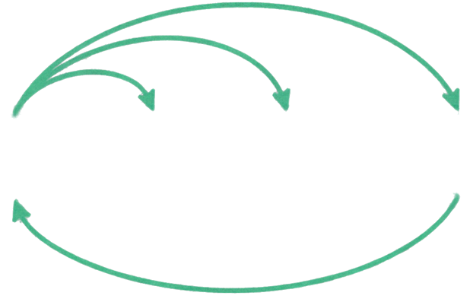







Xiao (2005): Theoretical Foundation
• Model: Y. Xiao, IEEE TWC 2005 (Markov Chain Model)
S0
S1
S2
Sk
• CWmin Impact: Governs short-term priority channel access
• AIFS Impact: Governs long-term inter-frame separation
• Mathematical Proof: AC_VO with CWmin = 3 triggers exponential collisions when N > 5

Slide 7





Simulation
Meets
Theory
Mangold (2003)
Xiao (2005)
Empirical reproduction to analytical explanation.
Empirical proof of voice saturation and starvation of lower-priority categories.
Theoretical proof of collision escalation under static CWmin=3.

Slide 8




Revising the Project Proposal
  Old plan (A1): broad measurement of general throughput degradation.
  Revised plan (A3): targeted mitigation of high-density contention collapse.
A1
A3
15
  Solution concept: the AP dynamically raises AC_VO CWmin from 3 to 15 when N≥6.
3
N≥6

Slide 9

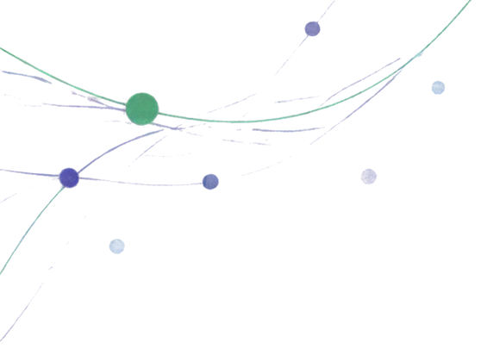

Thank you
IEEE 802.11e EDCA QoS Evaluation

